Slide 1
INF10025
Data Management and Analytics
Week 04 – Part 2
Visualizations

Slide 2
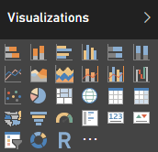
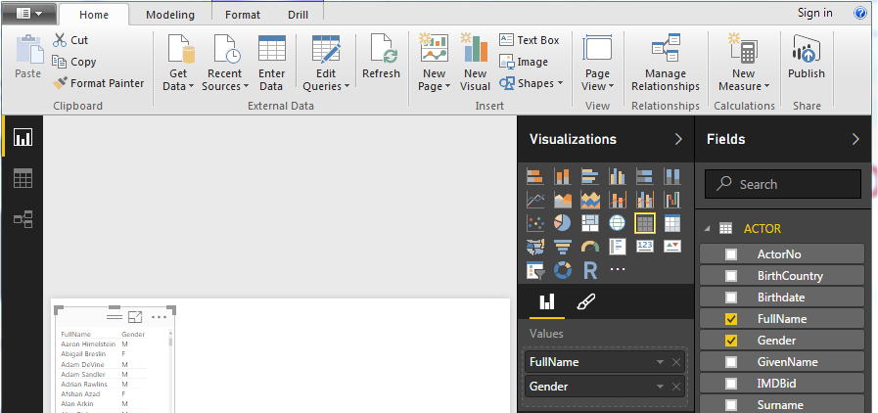
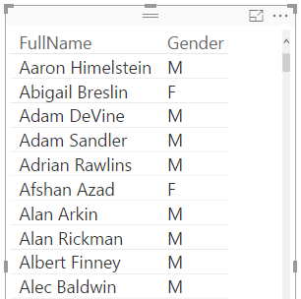
Power BI Visualizations
Data visualizations are created in the Report Window.
A number of visualizations are similar to Excel charts and Excel Power Pivot charts.
Many visualizations are unique to Power BI.
Typically, 1. Select a visualization. 2. Select fields to act as values for the visualization

Slide 3
Microsoft Power BI Desktop
Table visualization
Very similar to an Access Query.
Simply click that field names that you wish to add to the table visualization.
Each field name adds a column to the visualization.

Slide 4
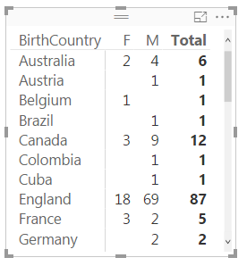
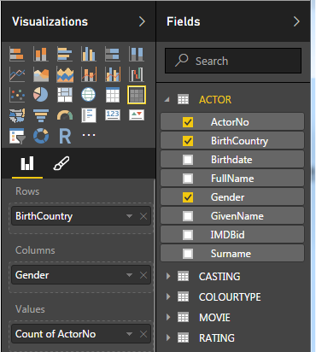
Microsoft Power BI Desktop
Matrix visualization
Very similar to an Access Crosstab Query or Excel Pivot Table.
Select a field for the row values (e.g BirthCountry)
Select a field for the column values (e.g Gender)
Select a field for aggregation (e.g. Count of ActorNo)

Slide 5
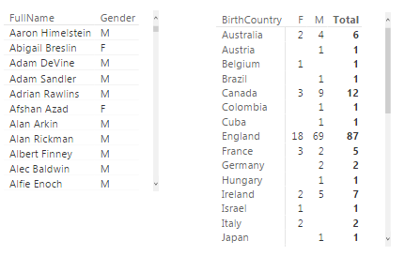
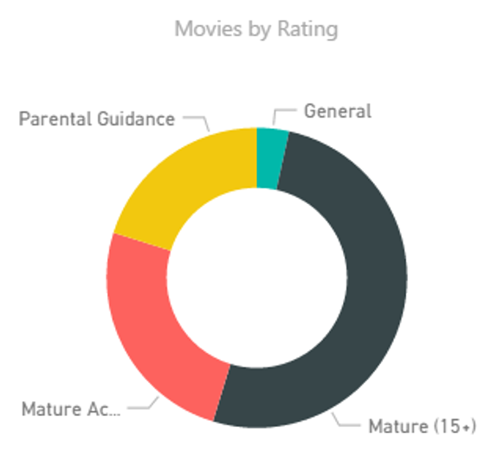
Microsoft Power BI Desktop
The Report workspace
Multiple visualizations can appear on a report at the one time
Actors by Gender
Actors by Birth Country

Slide 6

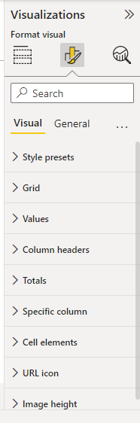
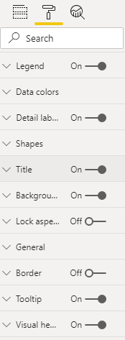
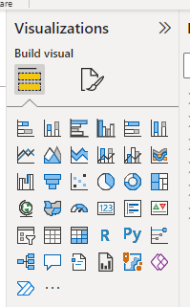
Microsoft Power BI Desktop
Customize the visualization setting via the Paintbrush icon
Some visualizations have 10 or more categories of settings
Click the paintbrush icon
to see the various visual
format settings for the visualization

Slide 7
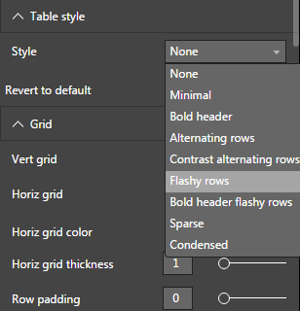
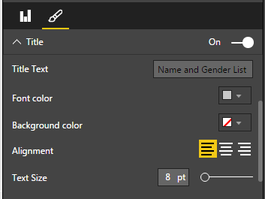
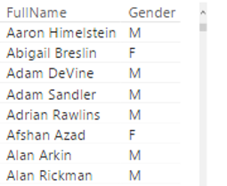
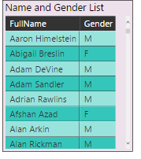
Microsoft Power BI Desktop
The settings for the visualization only apply to a single
visualization. The settings cannot be saved (although
you can save the entire workspace as a PBIX file).
If you delete a visualization and then recreate it, you will need
to recreate all of the settings again. ☹
Default style
Custom style

Slide 8

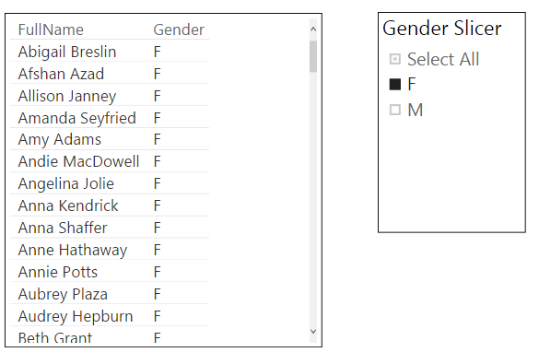
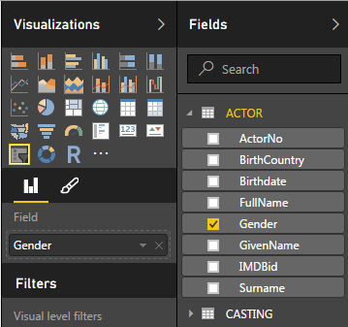
Microsoft Power BI Desktop
A slicer visualization is a visual filter.
The slicer applies to all other visualizations in the report

Slide 9
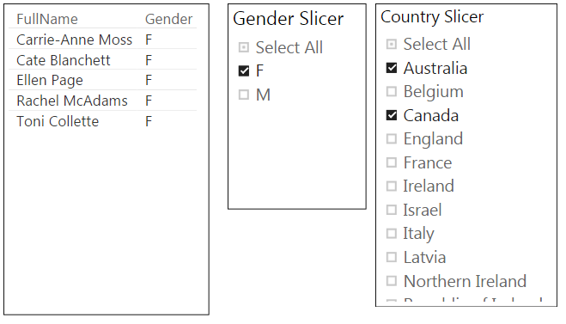
Microsoft Power BI Desktop
The report work area may have multiple slicers
The slicers have paintbrush icon settings that allow options such as
Only one box to be ticked
Multiple box to be ticked
Select All box

Slide 10
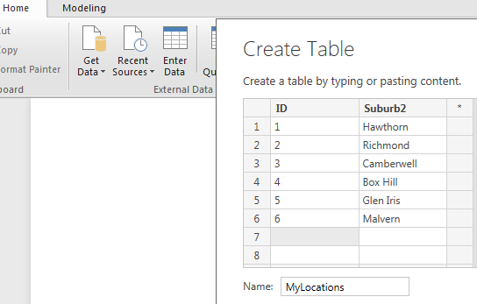
Microsoft Power BI Desktop
Power BI allows you to use data from multiple sources
This example allows the developer to create a new table (and data)
within the Power BI dataset.
Click Enter Data and select Create Table.
This example creates the table MyLocations and creates the ID and Suburb fields
Imagine that every customer record has a location id
of 1 to 6

Slide 11
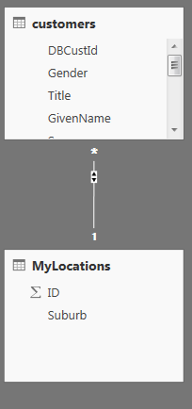
Microsoft Power BI Desktop
The new table can be added to the existing relationship diagram
customer.locationcode references MyLocations.id

Slide 12
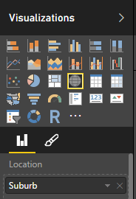
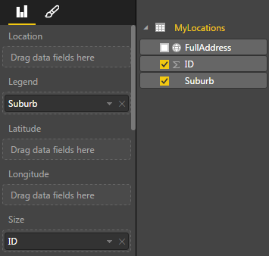


Microsoft Power BI
Map Visualization.
The Map visualization tool can highlight a geographical point on a map.
You can use any (all) of these to indicate a geographic point
  Suburb
  Town
  City
  State
  Country Name
  PostCode
  Longitude & Latitude co-ordinates
In this example the suburb name is used to identify a geographic location on a map

Slide 13
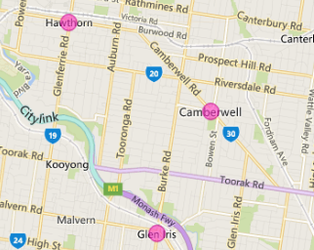
Microsoft Power BI Desktop
Map Visualization.
Power BI places dots on the Map.
The size of the dot is specified in the Size property.
Here we have used ID – not very meaningful.
Typically we would use CountOfCustId or
SumOfSaleQty

Slide 14
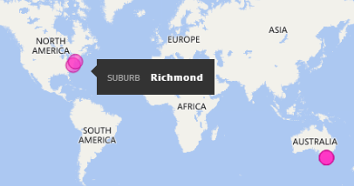
Microsoft Power BI Desktop
There is often a problem with individual suburb names, town names, postcodes etc.
Power BI is a little bit North America - centric.
In such situations you may have to provide more specific location information.

Slide 15
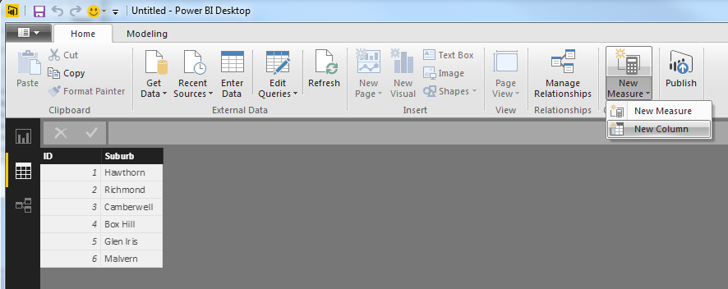
Microsoft Power BI Desktop
In this example, we will add a new field to an existing table.
Under the New Measure icon, select the New Column option.

Slide 16
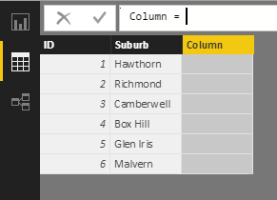
Microsoft Power BI Desktop
This is where it can be confusing.
The formula bar is when you enter the new field name.
Replace the phrase "Column = " with …

Slide 17
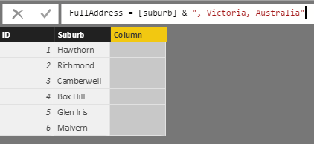
Microsoft Power BI Desktop
…
The name of the new field (e.g. FullAddress)
Then =
The new calculation (e.g. [suburb] & ", Victoria, Australia"
Note: The ampersand character & is used to join / concatenate string values.

Slide 18
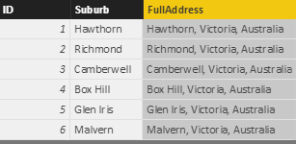
Microsoft Power BI Desktop
A new field named FullAddress has been built and populated.
This new data can be used by the Map visualization with far better results

Slide 19
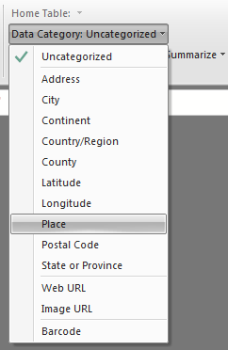
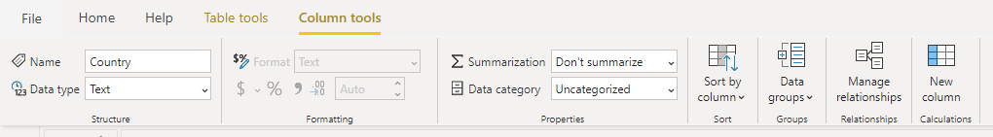
Microsoft Power BI Desktop
Power BI also allows you to categorize type of data in a table
Click on a field and click a matching category type

Slide 20
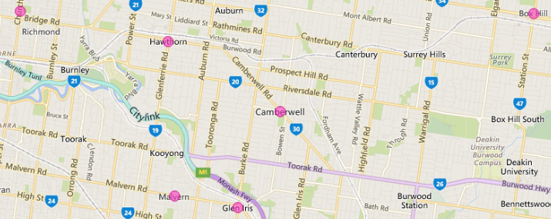
Microsoft Power BI Desktop
Now when the data is displayed, all the locations should be confined to the country, state etc. that you specified.

Slide 21
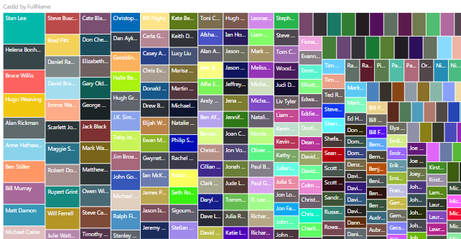
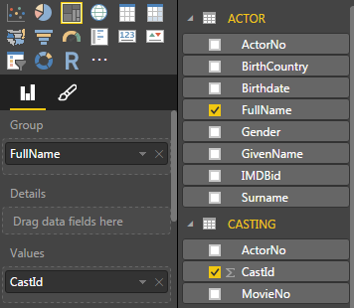
Microsoft Power BI Desktop
Tree Map visualization. A rectangle is drawn for each data value.
The bigger the rectangle the bigger the data values.
This example highlights the count of castings for each actor.
Many rectangles are very small (an actor may only have 1 casting).

Slide 22
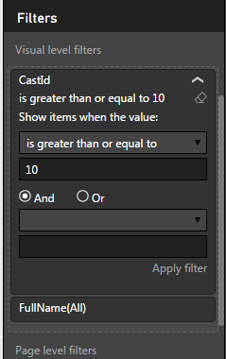
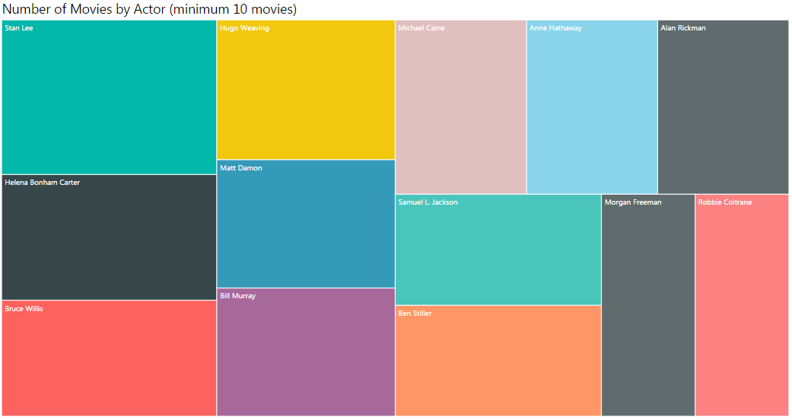
Microsoft Power BI Desktop
Most visualizations have a Visual Filter setting.
In this case the minimum Count of Castings has been set at 10
Rectangles only appear for actors who meet this criteria.

